Slide 1
Building your first app; an introduction to MongoDB
#MongoDBDays
Thomas Rückstieß
Technical Support Engineer thomas@10gen.com
Notes:
Welcome to our first presentation: This is our introduction talk to MongoDB “Hello World” of MongoDB, where we go over the basic concepts.
The later talks today will then go into more detail for each of the topics.

Slide 2
Notes to the presenter
Themes for this presentation:
First presentation in the conference. Keep it fun
User is likely brand new to MongoDB and comes from traditional relational background
This is an introduction. Don't go deep.. Introduce concepts and refer to later presentations that build on these concepts.

Slide 3
What is MongoDB

Slide 4
MongoDB is a ___________ database
Document
Open source
High performance
Horizontally scalable
Full featured
Notes:
NoSQL – true, but that doesn’t really explain what MongoDB is.
Here are some of the buzzwords that describe MongoDB

Slide 5
Document Database
Not for .PDF & .DOC files
A document is essentially an associative array
Document == JSON object
Document == PHP Array
Document == Python Dictionary
Document == Ruby Hash
etc
Notes:
Documents with key/value pairs, that can contain nested sub-documents or arrays

Slide 6
Open Source
MongoDB is an open source project
On GitHub
Licensed under the AGPL
Commercial licenses available
Started & sponsored by 10gen
Contributions welcome
Notes:
AGPL – GNU Affero General Public License

Slide 7
High Performance
Written in C++
Extensive use of memory-mapped files i.e. read-through write-through memory caching.
Runs nearly everywhere
Data serialized as BSON (fast parsing)
Full support for primary & secondary indexes
Document model = less work
Notes:
Have to remember: MongoDB was created by developers for developers. Have been working relational databases and realizes how painful it can be.
Want to make things easier, and faster.

Slide 8
Horizontally Scalable
Notes:
Example: startup, great social application that lets you share photos of food.
made it to a critical mass of users, just taking off.

Slide 9
Full Featured
Ad Hoc queries
Real time aggregation
Rich query capabilities
Traditionally consistent
Geospatial features
Support for most programming languages
Flexible schema
Notes:
One of the tricky things about designing a no-sql database:

Slide 10
Database Landscape
Notes:
Slow down: not only design process but also the actual application
Much faster than RDBMS
Much more functionality than key-value

Slide 11
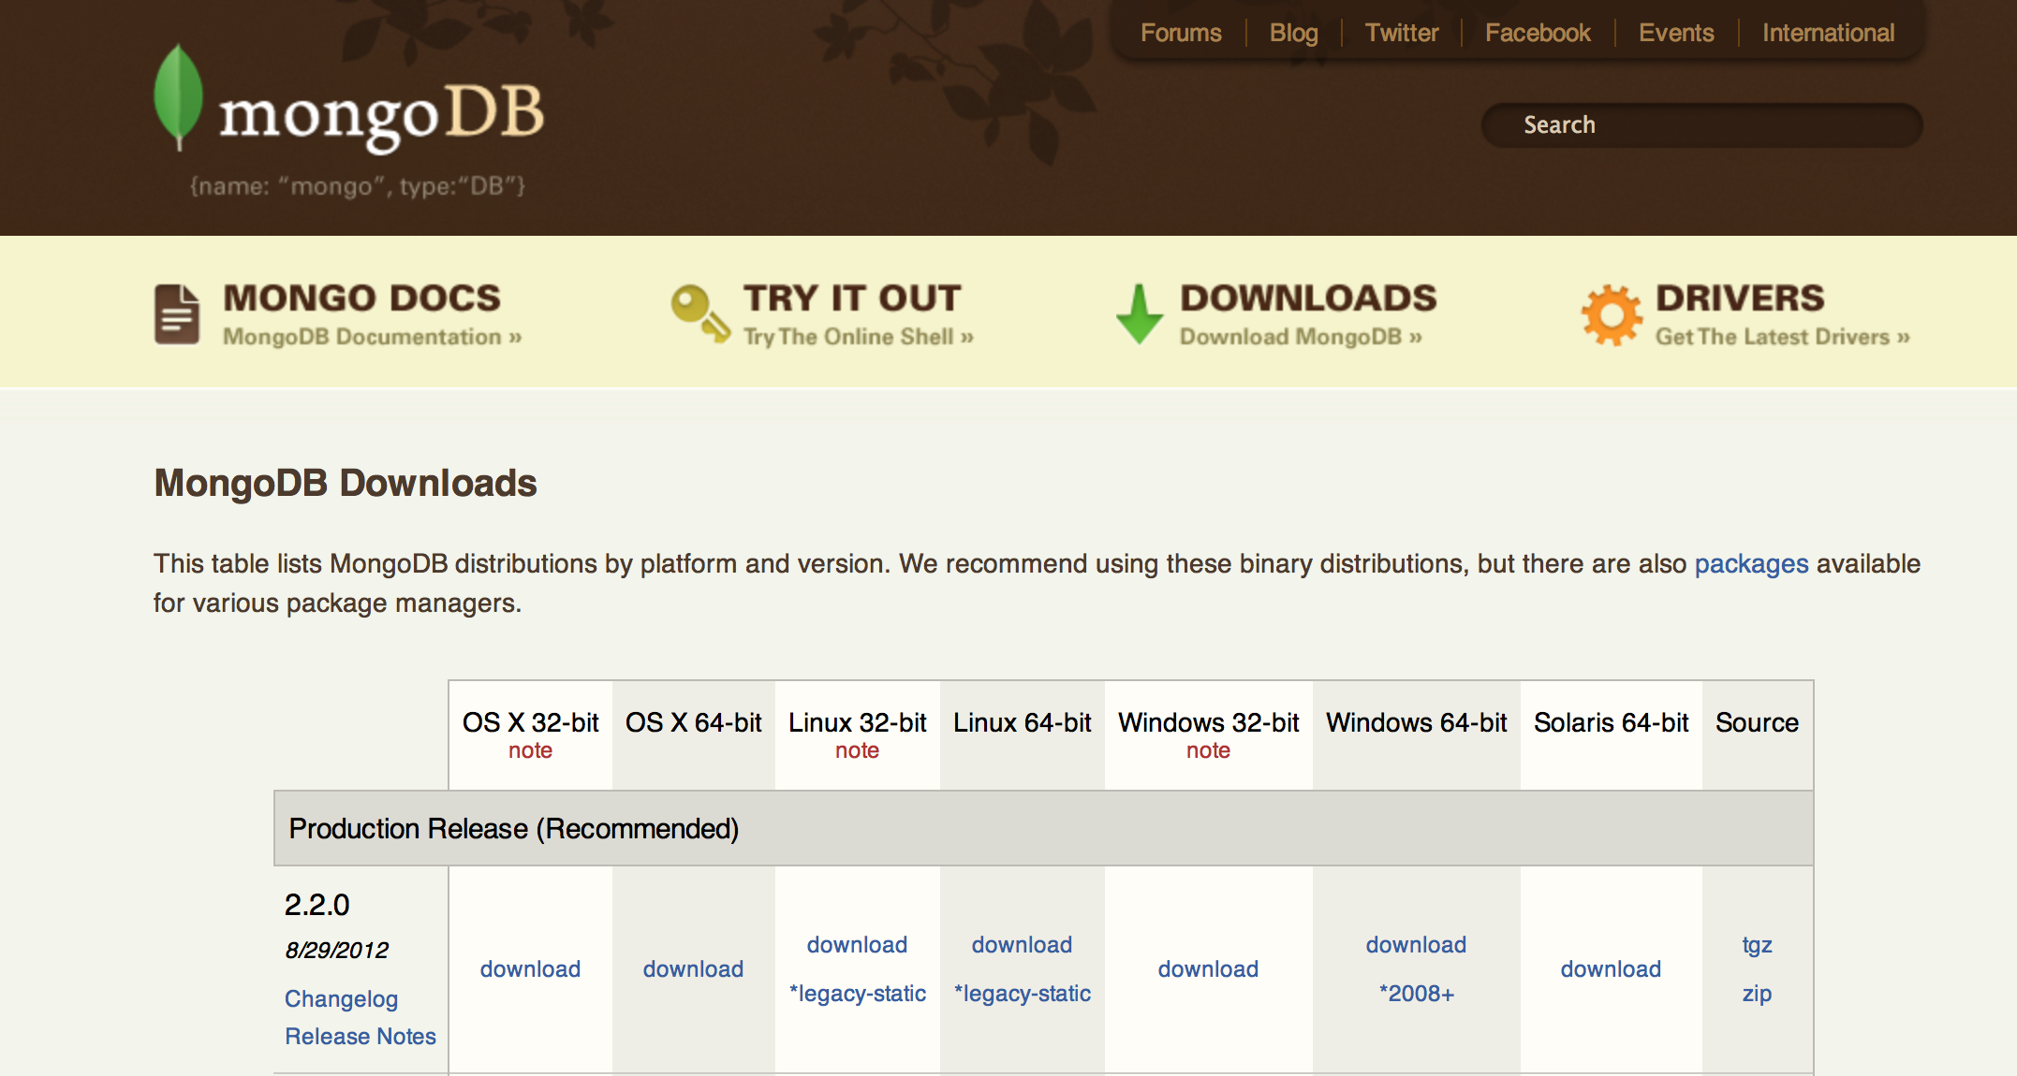
http://www.mongodb.org/downloads
Notes:
Let’s get started:
Latest version!

Slide 12
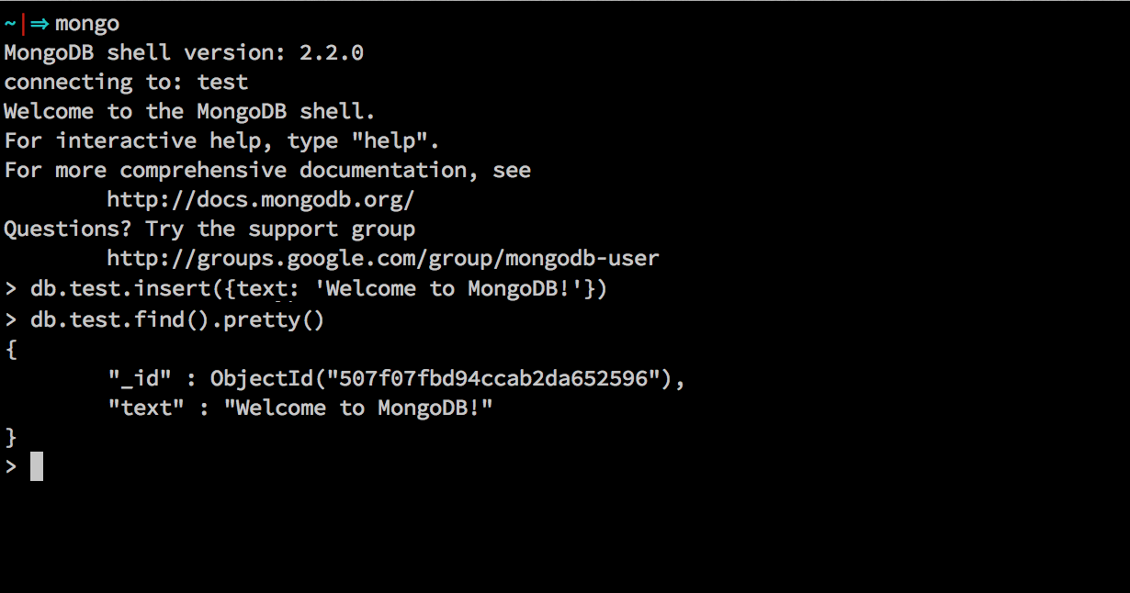
Mongo Shell
Notes:
MongoD – single standalones and replicasets
MongoS – sharded systems
Mongo – Shell

Slide 13
Document Database
Notes:
Repeat:
Buzzword Bingo
Know where MongoDB lives on the Database landscape
Know where to download it
Spin up a mongod and a mongo shell and you’re good to go.

Slide 14
Terminology
RDBMS |  | MongoDB
Table, View | ➜ | Collection
Row | ➜ | Document
Index | ➜ | Index
Join | ➜ | Embedded Document
Foreign Key | ➜ | Reference
Partition | ➜ | Shard
Notes:
Not equal
you can think of “similar”
Join: normalized data

Slide 15
Typical (relational) ERD
Notes:
Kristine to update this graphic at some point
Simple example,
Blog post, comments, articles,

Slide 16
MongoDB ERD
Notes:
Schema design talk later today
traditionally, there’s one design
ONE way of model the data, but not the only one
This is why people like MongoDB

Slide 17

We will build a library management application
http://www.flickr.com/photos/somegeekintn/3484353131/
Notes:
Quick story.

Slide 18
First step in any application is
Determine your entities

Slide 19
Library Management Application Entities
Library Patrons (users)
Books (catalog)
Authors
Publishers
Categories ??
Notes:
Ask question: Is categories it's own entity? It could be, but it's likely a property of books.
- categories: figure it out as we go forward

Slide 20
In a relational based app
We would start by doing schema design

Slide 21
Relational schema design
Large ERD Diagrams
Complex create table statements
ORMs to map tables to objects
Tables just to join tables together
For this simple app we'd have 5 tables and 5 join tables
Lots of revisions until we get it just right

Slide 22
In a MongoDB based app
We start building our app
and let the schema evolve

Slide 23
MongoDB collections
Users
Books
Authors
Publishers
Notes:
Notice how they are the same as the entities listed above

Slide 24
No common language so using the shell

Slide 25
Working with MongoDB

Slide 26
Start with an object (or array, hash, dict, etc)
user = {
username: 'fred.jones',
first_name: 'fred',
last_name: 'jones’
}

Slide 27
Insert the record
> db.users.insert(user)
No collection creation needed

Slide 28
Querying for the user
> db.users.findOne()
{
"_id" : ObjectId("50804d0bd94ccab2da652599"),
"username" : "fred.jones",
"first_name" : "fred",
"last_name" : "jones"
}

Slide 29
_id
_id is the primary key in MongoDB
Automatically indexed
Automatically created as an ObjectId if not provided
Any unique immutable value could be used

Slide 30
ObjectId
ObjectId is a special 12 byte value
Guaranteed to be unique across your cluster
ObjectId("50804d0bd94ccab2da652599") |-------------||---------||-----||----------| ts mac pid inc
Notes:
"50804d0bd94ccab2da652599" is a 24 byte string (12 byte ObjectId hex encoded).

Slide 31
Creating an author
> db.author.insert({
first_name: 'j.r.r.',
last_name: 'tolkien',
bio: 'J.R.R. Tolkien (1892.1973), beloved throughout the world as the creator of The Hobbit and The Lord of the Rings, was a professor of Anglo-Saxon at Oxford, a fellow of Pembroke College, and a fellow of Merton College until his retirement in 1959. His chief interest was the linguistic aspects of the early English written tradition, but even as he studied these classics he was creating a set of his own.'
})
Notes:
Powerful message here.
Finally a database that enables rapid & agile development.
Authors (plural)

Slide 32
Querying for our author
> db.author.findOne( { last_name : 'tolkien' } )
{
"_id" : ObjectId("507ffbb1d94ccab2da652597"),
"first_name" : "j.r.r.",
"last_name" : "tolkien",
"bio" : "J.R.R. Tolkien (1892.1973), beloved throughout the world as the creator of The Hobbit and The Lord of the Rings, was a professor of Anglo-Saxon at Oxford, a fellow of Pembroke College, and a fellow of Merton College until his retirement in 1959. His chief interest was the linguistic aspects of the early English written tradition, but even as he studied these classics he was creating a set of his own."
}

Slide 33

Creating a Book
> db.books.insert({
title: 'fellowship of the ring, the',
author: ObjectId("507ffbb1d94ccab2da652597"),
language: 'english',
genre: ['fantasy', 'adventure'],
publication: {
name: 'george allen & unwin',
location: 'London',
date: new Date('21 July 1954'),
}
})
http://society6.com/PastaSoup/The-Fellowship-of-the-Ring-ZZc_Print/
Notes:
Creating a book here. A few things to make note of.

Slide 34
Multiple values per key
> db.books.findOne({language: 'english'}, {genre: 1})
{
"_id" : ObjectId("50804391d94ccab2da652598"),
"genre" : [
"fantasy",
"adventure"
]
}

Slide 35
Querying for key with multiple values
> db.books.findOne({genre: 'fantasy'}, {title: 1})
{
"_id" : ObjectId("50804391d94ccab2da652598"),
"title" : "fellowship of the ring, the"
}
Query key with single value or multiple values the same way.
Notes:
(email) Brandon – remove
Make more obvious

Slide 36
Nested Values
> db.books.findOne({}, {publication: 1})
{
"_id" : ObjectId("50804ec7d94ccab2da65259a"),
"publication" : {
"name" : "george allen & unwin",
"location" : "London",
"date" : ISODate("1954-07-21T04:00:00Z")
}
}

Slide 37
Reach into nested values using dot notation
> db.books.findOne(
{'publication.date' :
{ $lt : new Date('21 June 1960')}
}
)
{
"_id" : ObjectId("50804391d94ccab2da652598"),
"title" : "fellowship of the ring, the",
"author" : ObjectId("507ffbb1d94ccab2da652597"),
"language" : "english",
"genre" : [ "fantasy", "adventure" ],
"publication" : {
"name" : "george allen & unwin",
"location" : "London",
"date" : ISODate("1954-07-21T04:00:00Z")
}
}

Slide 38
Update books
> db.books.update(
{"_id" : ObjectId("50804391d94ccab2da652598")},
{ $set : {
isbn: '0547928211',
pages: 432
}
})
True agile development.
Simply change how you work with
the data and the database follows
Notes:
Powerful message here.
Finally a database that enables rapid & agile development.

Slide 39
The Updated Book record
db.books.findOne()
{
"_id" : ObjectId("50804ec7d94ccab2da65259a"),
"author" : ObjectId("507ffbb1d94ccab2da652597"),
"genre" : [ "fantasy", "adventure" ],
"isbn" : "0395082544",
"language" : "english",
"pages" : 432,
"publication" : {
"name" : "george allen & unwin",
"location" : "London",
"date" : ISODate("1954-07-21T04:00:00Z")
},
"title" : "fellowship of the ring, the"
}

Slide 40
Creating indexes
> db.books.ensureIndex({title: 1})
> db.books.ensureIndex({genre : 1})
> db.books.ensureIndex({'publication.date': -1})
Notes:
What slows them down is not using indexes.
Most important. Mention this.
Font size on last one

Slide 41
Querying with RegEx
> db.books.findOne({title : /^fell/})
{
"_id" : ObjectId("50804ec7d94ccab2da65259a"),
"author" : ObjectId("507ffbb1d94ccab2da652597"),
"genre" : [ "fantasy", "adventure" ],
"isbn" : "0395082544",
"language" : "english",
"pages" : 432,
"publication" : {
"name" : "george allen & unwin",
"location" : "London",
"date" : ISODate("1954-07-21T04:00:00Z")
},
"title" : "fellowship of the ring, the"
}
Notes:
Maybe move this slide

Slide 42

Adding a few more books
> db.books.insert({
title: 'two towers, the',
author: ObjectId("507ffbb1d94ccab2da652597"),
language: 'english',
isbn : "034523510X",
genre: ['fantasy', 'adventure'],
pages: 447,
publication: {
name: 'george allen & unwin',
location: 'London',
date: new Date('11 Nov 1954'),
}
})
http://society6.com/PastaSoup/The-Two-Towers-XTr_Print/
Notes:
Creating a book here. A few things to make note of.

Slide 43

Adding a few more books
> db.books.insert({
title: 'return of the king, the',
author: ObjectId("507ffbb1d94ccab2da652597"),
language: 'english',
isbn : "0345248295",
genre: ['fantasy', 'adventure'],
pages: 544,
publication: {
name: 'george allen & unwin',
location: 'London',
date: new Date('20 Oct 1955'),
}
})
http://society6.com/PastaSoup/The-Return-of-the-King-Jsc_Print/
Notes:
Creating a book here. A few things to make note of.

Slide 44
Cursors
> db.books.find(
{ author: ObjectId("507ffbb1d94ccab2da652597")})
.sort({ 'publication.date' : -1})
.limit(1)
{
"_id" : ObjectId("5080d33ed94ccab2da65259d"),
"title" : "return of the king, the",
"author" : ObjectId("507ffbb1d94ccab2da652597"),
"language" : "english",
"isbn" : "0345248295",
"genre" : [ "fantasy", "adventure" ],
"pages" : 544,
"publication" : {
"name" : "george allen & unwin",
"location" : "London",
"date" : ISODate("1955-10-20T04:00:00Z")
}
}

Slide 45
Paging
page_num = 3; results_per_page = 10; cursor = db.books.find() .sort({ "publication.date" : -1 }) .skip((page_num - 1) * results_per_page) .limit(results_per_page);
Notes:
This is fine for small result sets. Not good performance for large result sets. Range query plus limit will give better performance.

Slide 46
Finding author by book
> book = db.books.findOne(
{"title" : "return of the king, the"})
> db.author.findOne({_id: book.author})
{
"_id" : ObjectId("507ffbb1d94ccab2da652597"),
"first_name" : "j.r.r.",
"last_name" : "tolkien",
"bio" : "J.R.R. Tolkien (1892.1973), beloved throughout the world as the creator of The Hobbit and The Lord of the Rings, was a professor of Anglo-Saxon at Oxford, a fellow of Pembroke College, and a fellow of Merton College until his retirement in 1959. His chief interest was the linguistic aspects of the early English written tradition, but even as he studied these classics he was creating a set of his own."
}

Slide 47
MongoDB Drivers

Slide 48
Real applications are not built in the shell
Notes:
Remove XYZ

Slide 49
MongoDB has native bindings for over 12 languages

Slide 50
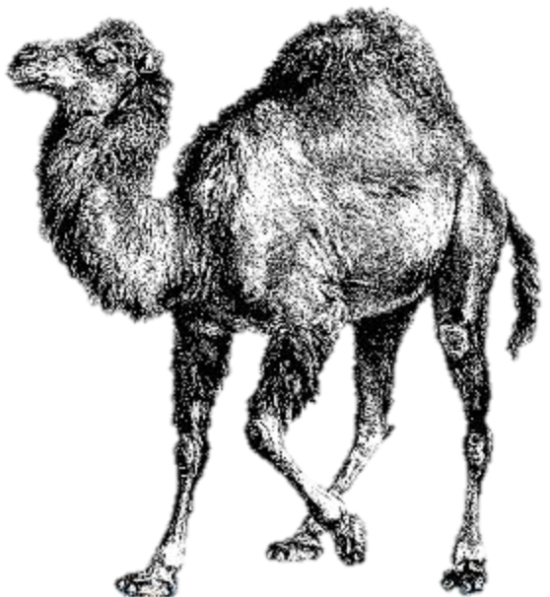

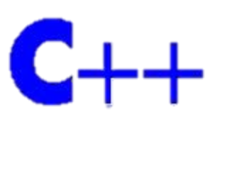









Notes:
10gen Drivers
Java, C, C++, C#, PHP, Python, Ruby, Perl, Javascript, Node.js, Erlang, Scala

Slide 51



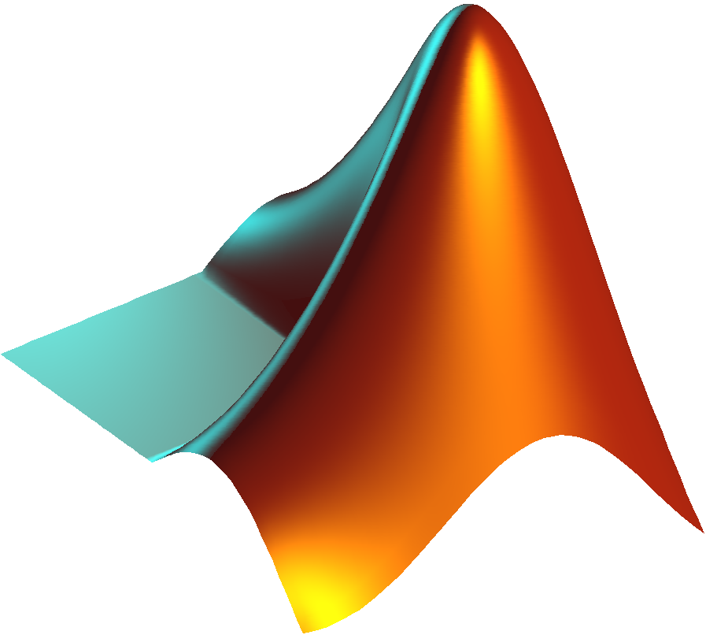






Notes:
Plus community drivers.
ActionScript, Clojure, ColdFusion, D, Dart, Delphi, Entity, Factor, Fantom, F#, Go, Groovy, Lisp, Lua, MatLab, Objective-C, Opa, PowerShell, Prolog, R, REST, Racket, Smalltalk

Slide 52
MongoDB drivers
Official Support for 12 languages
Community drivers for tons more
Drivers connect to mongo servers
Drivers translate BSON into native types
mongo shell is not a driver, but works like one in some ways
Installed using typical means (npm, pecl, gem, pip)

Slide 53
Next Steps

Slide 54
We've introduced a lot of concepts here

Slide 55
Schema Design @ 10:35 am
Notes:
This graphic should be updated at some point.

Slide 56
Replication @ 11:30 am
Notes:
Work –

Slide 57
Sharding @ 12:15 pm

Slide 58
Indexing @ 14:30 pm

Slide 59
Questions? Fragen?
#MongoDBDays
Schema Design @ 10:35
Replication @ 11:30
Sharding @ 12:15
Indexing @ 14:30
Thomas Rückstieß
Technical Support Engineer thomas@10gen.com
Notes:
Come back to introduction.
As u can see mongodb was built to give u a better experience …
We worked very hard to get you the functionality you need
Just as good for devs and ops people
Use your poker chips

